Slide 1
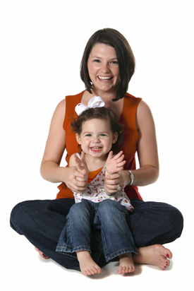
creating sound minds through musical play
parent orientation

Slide 2
what is it?
• a precursor to Let’s Play Music and kindergarten
explores both music and academic skills and concepts
• activities that nurture the parent-child relationship
• fully embraces the philosophies, methodologies, and vision of lpm
• repertoire consists of folk songs,
chants, nursery rhymes and
well-known classical pieces
Expose children to the “best” music

Slide 3
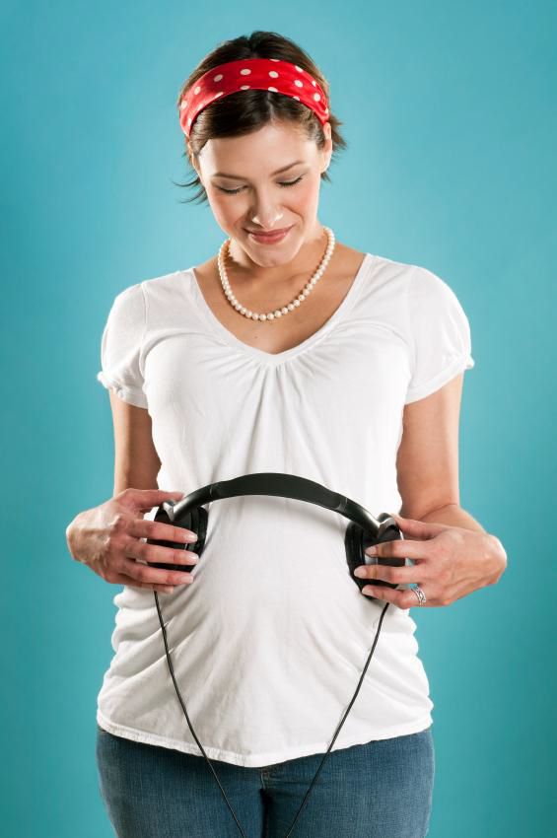
why?
• bond parent to child
sound beginnings provides the tools and the environment necessary for parents and children to play and learn together
• the ‘music window’
the earlier the better
•developing the musician within
• smarter, more aesthetic children
To enrich lives, increase confidence, develop talent, enhance intelligence and bond parent to child

Slide 4
the child’s brain
- age 0-3 is the flexible developmental phase of the brain.
- experiences during these years determine the child’s capacity for intelligence.
- connections that are not used will disappear.
- the most important time for music education is age 3-7, but education before and after are very important as well.

Slide 5
singing!
- students will develop their singing voices at their own pace and in their own way.
- there are two SOL-MI songs per semester to allow for successful in-tune singing experiences with developing voices.

Slide 6
what this means to you?
Have realistic expectations for your child and their singing voice.
Let them master the simple songs first and find success.
Let them explore the wonderful (and developing) instrument of their voice!
Praise them for any singing attempts they make
Sing with them regardless of how you classify your own singing ability

Slide 7
questions?
To the casual observer- Sound Beginnings just looks like a lot of fun. And it is! But there is a specific purpose for every activity in the curriculum.
If you ever have a question about why we are doing something- just ask!

Slide 8
parking
Please park in my driveway FIRST and then directly in front of my house as needed along the white picket fence. I will have permits for each car.
Of course, watch for small children so everyone can stay safe.

Slide 9
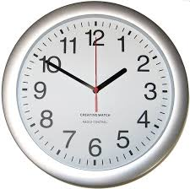
come on in!
Classes will start and end on time. I will put a sign out by my front of my door 5-10 minutes before class starts. This is the signal that you can come in. Please do just that- come on in! I will not be answering the door with each student arrival. Slip off your shoes and come on in!

Slide 10
join us!
We will sit on the floor during class. This helps with the bonding experience- so you can be on the same level as your child. (They will sit right in front of you or in your lap) There is also a lot of "up and down" during class.

Slide 11
please un-plug!
One of the beauties of Sound Beginnings is the parent/child bonding experience! Please help this happen by waiting until the end of class to reply to texts or phone messages. Do feel free to take video or pictures to post on social media. Tag @playyourpartmt!

Slide 12
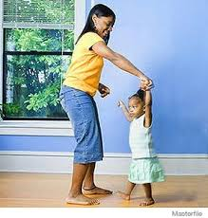
please participate!
Your child is watching you. If you are participating- they will want to as well.
Sound Beginnings is a "no judgment" zone for the kids and the parents! Please sing and dance along with us! If the parent continues to show enthusiasm for the program, the child will also.

Slide 13
do not force participation
Our music class is a safe place. Children are learning just by being here. If they choose not to participate, even if I have invited them to, it is OK!
"If you lecture, bribe, or scold your child for lack of participation, they may associate negative feelings with the class and their experience here. “
** Student Workbook

Slide 14
having a bad day?
It happens to the best of us. If your child is having a bad day, please take them the waiting room or outside for a little break/breather and then rejoin us when they are ready

Slide 15
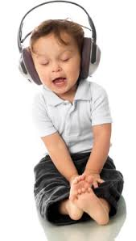
listen to the CD
…. as much as possible! Every time you listen to the CD, you are reinforcing concepts being taught in class.
Bedtime or travelling around in the car is a GREAT time to make this happen.

Slide 16
the workbook
Please bring your workbook to every class. We will use them! You will receive them at the 1st or 2nd class!
Inside the front cover is a class calendar
There is also an optional at home activity for each weekly lesson included on the calendar.
I will not be grading these optional activities or taking note of who did what. But your child will have the option to use their own puppet that they colored during the next class.
There is a ziploc bag in the back of your workbook to hold the puppets.

Slide 17
more bang for your buck!
"To further enhance your child's experience, Do the in-class activities at home, sing the songs without the CD, encourage your child to use their music book, and create new ways to experience the songs. Share your ideas in class!"
**Student Workbook

Slide 18
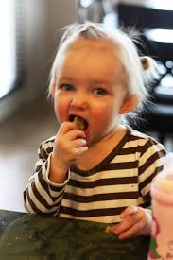
no food or snacks!
Please do not eat food or snacks during class time.
Also, please let me know if your child has any food allergies. (There may be a small treat on the last day of class)

Slide 19
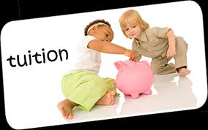
tuition
Tuition is due in 4 payments due on lesson 1, 5, 9, and 13. If you prefer, you can pay for the entire semester up front. Registration in Sound Beginnings is a commitment for one semester. Tuition is due for the entire semester, even if you need to withdraw early.

Slide 20
contact me
If you are not able to attend class, please let me know in advance that you will be gone.
email brianna@playyourpartmusic.com
or
text 949-630-8636

Slide 21
thank you!
Thank you for reading through our Parent Orientation!
I LOVE the Sound Beginnings program, both as a teacher and as a parent. It is exciting to share the wonderful world of music with your precious children.
I look forward to seeing everyone in class!

